Slide 1
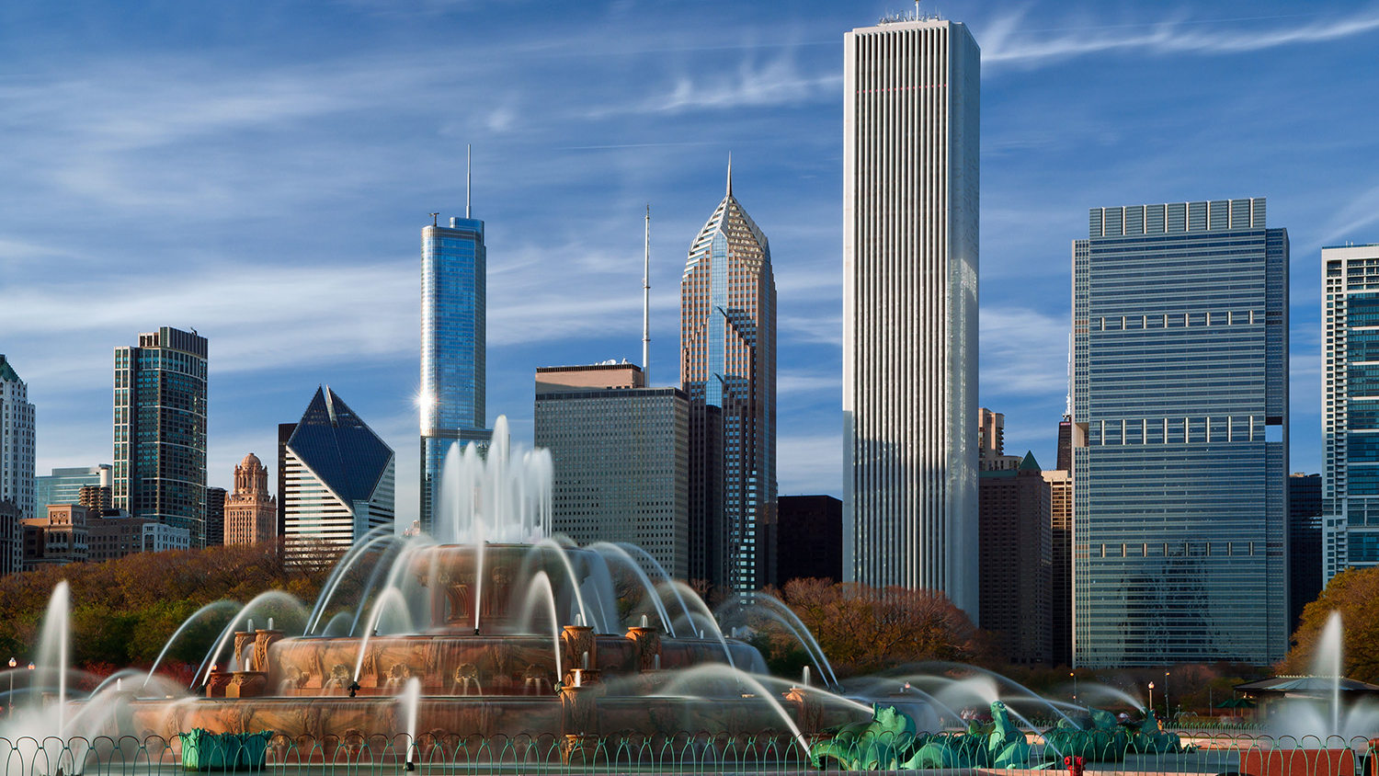
Welcome to Chicago
October 12-14, 2017

Slide 2
Chicago River & Beaches
View from DuSable Bridge, North Avenue Beach

Slide 3
Millennium Park
Cloud Gate and Pritzker Pavilion

Slide 4
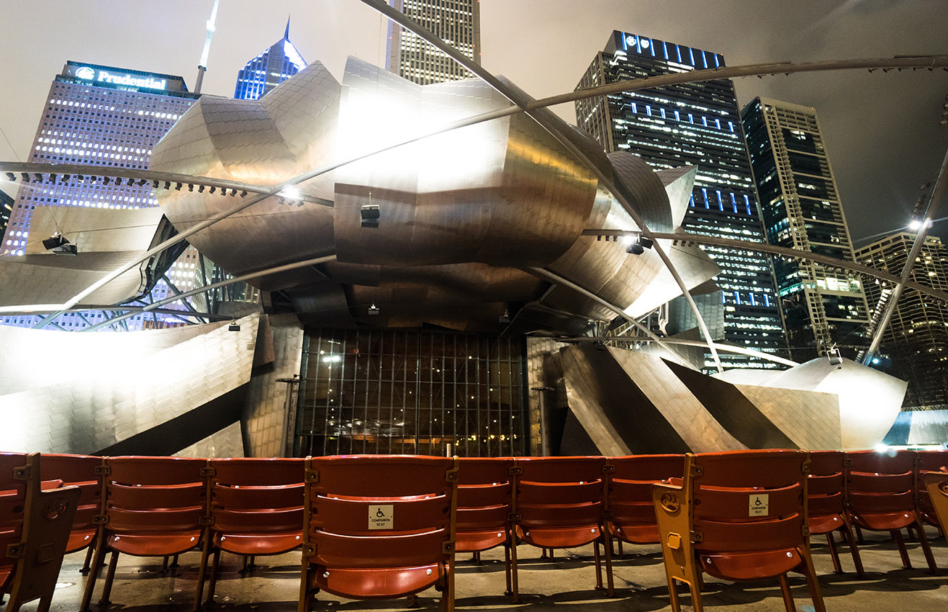
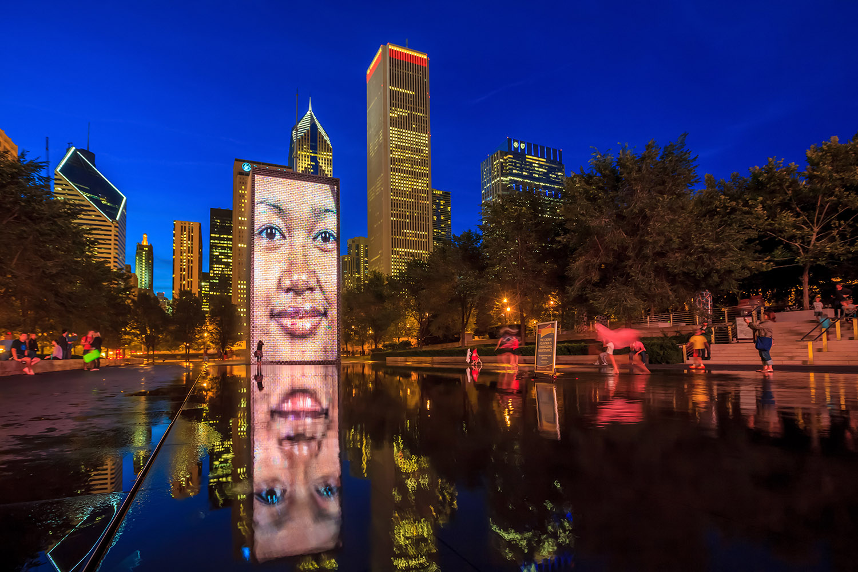
Millennium Park
Pritzker Pavilion (day, night), Crown Fountain

Slide 5
Aon Center
Mid America Club , View from our Meeting Room

Slide 6
Mid America Club
Meeting Room, Club Facilities

Slide 7
Fairmont Chicago, Millennium Park
Reception

Slide 8
Fairmont Chicago
Bed, View from 37th Floor, Bath

Slide 9
Fairmont Chicago
Spa Reception, Steam Room

Slide 10
Fine Dining on Premises
Columbus Tap

Slide 11
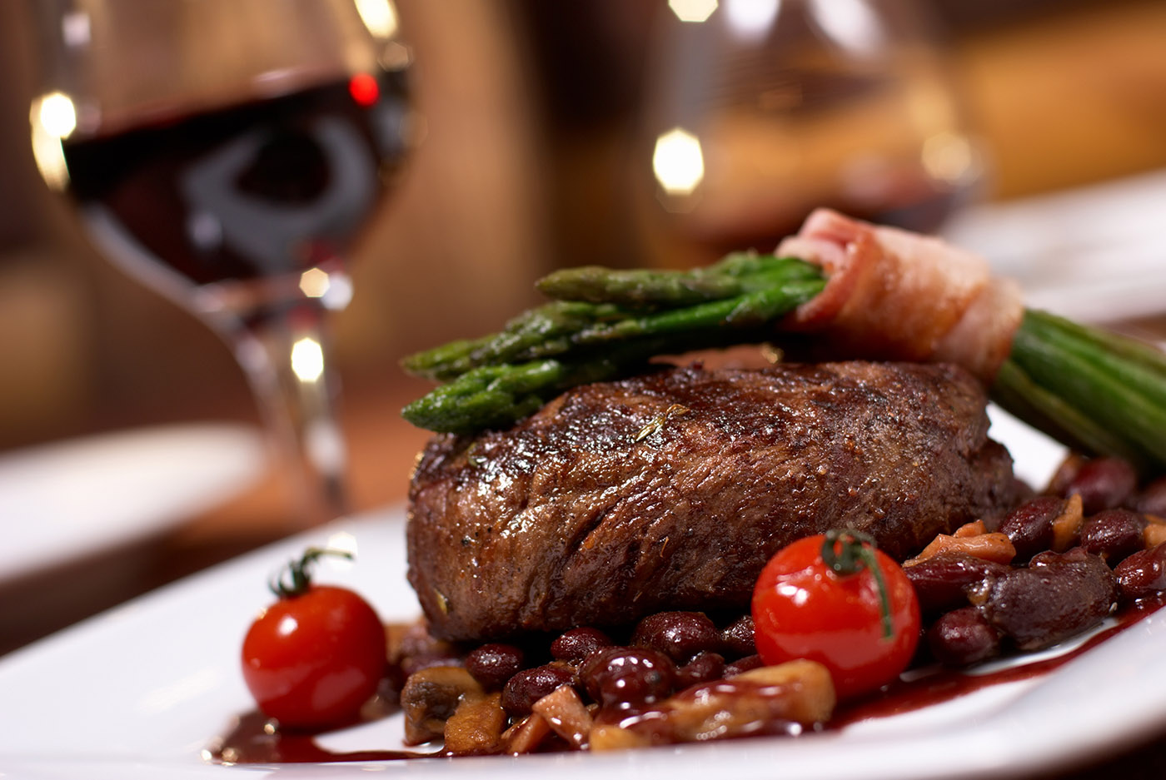
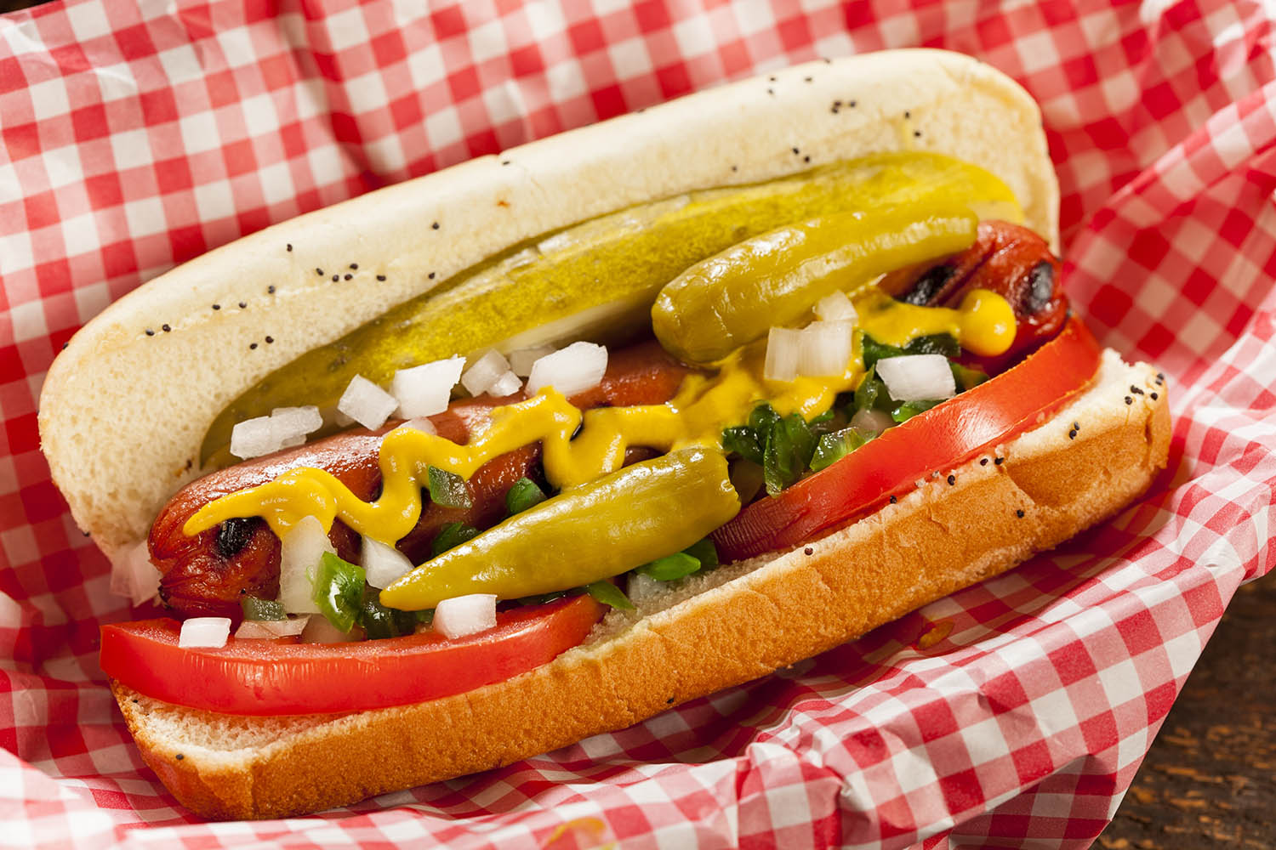
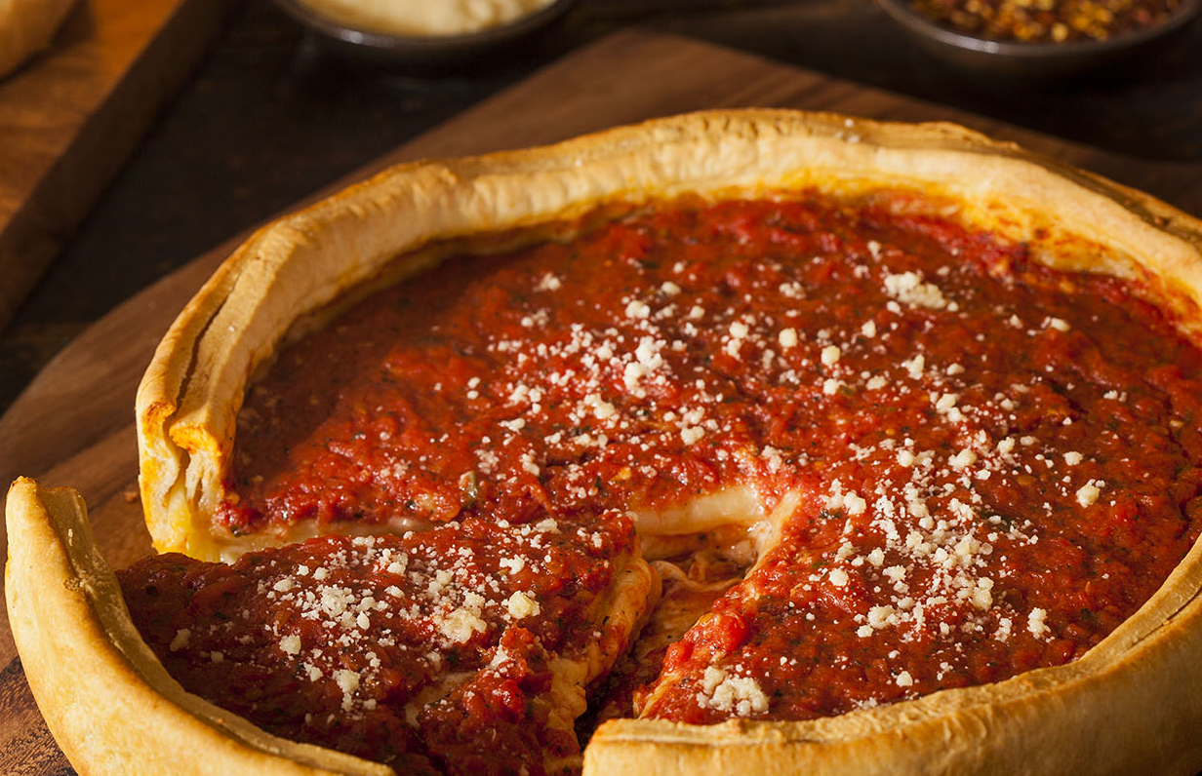
Chicago Favorites
Kettle corn, steak, hot dogs, deep dish pizza

Slide 12
Looking forward to seeing you!

